Slide 1
How To Customer Pages
Guide for how the customer pages are set up

Slide 2
Process Info
Owner name | Annarose Peterson
Team | DnD
Resources | Docebo
Tools | HTML editing software, Course Card template, Graphic for Customer Pages sections
Description | Guide to the set up of the Customer Pages in AU
 | AU Member | AU Member | AU Member | AU Member | AU Member | AU Member | AU Member | AU Member | AU Member
Date

Slide 3
Overview
This is a guide on how each customer page was built along with the resources/codes used on the pages.
Homepage product cards, and the legend image can be edited on the Graphic for Customer Pages
Course cards are created with the AU V2 Generic Thumbnail
All parts of the pages that use HTML, you can refer to How to edit an HTML widget on AU pages.pptx for instructions on how to edit
The course card images all make use of CSS that point to the property “aushadow”, if you are editing HTML widgets, make sure the image tag is updated as follows: <image class=“aushadow”
All images and files associated with customer pages are located here: Customer Pages

Slide 4

Page General Settings
Instructions on how to build pages are found here: How to set up pages in AU.pptx
All General Settings for Customer pages are as follows:
Code: CUS-XXX
XXX is an abbreviation of the product or description of the page you are building.
For example, a customer page for Amplify would have the code “CUS-APIM”
Page Name: put full page name
Page Description: Add a description of what the page is used for
If it is a product page the description should read: “Product Training for Customers”
Page icon:
If it is the homepage, use:
If it is any other customer page, use this icon:
Additional Page options: All options should be turned off.

Slide 5
Menu Settings
Instructions on how to create or manage existing menus are here: How to manage menus in AU.pptx
Menu set up:
New menus for Customers is not necessary, as we have existing ones.
Follow these principles for menus to use when creating new pages or managing existing pages:
If the page must appear on the User menu for customers, add the page to the menu titled Customers (menu code: CUS-MENU)
If the page does not need to appear on the user menu, but customers should still have access and visibility to the page, add the page to the menu titled Menu to make customer pages visible (menu code: CUS-VIS)

Slide 6
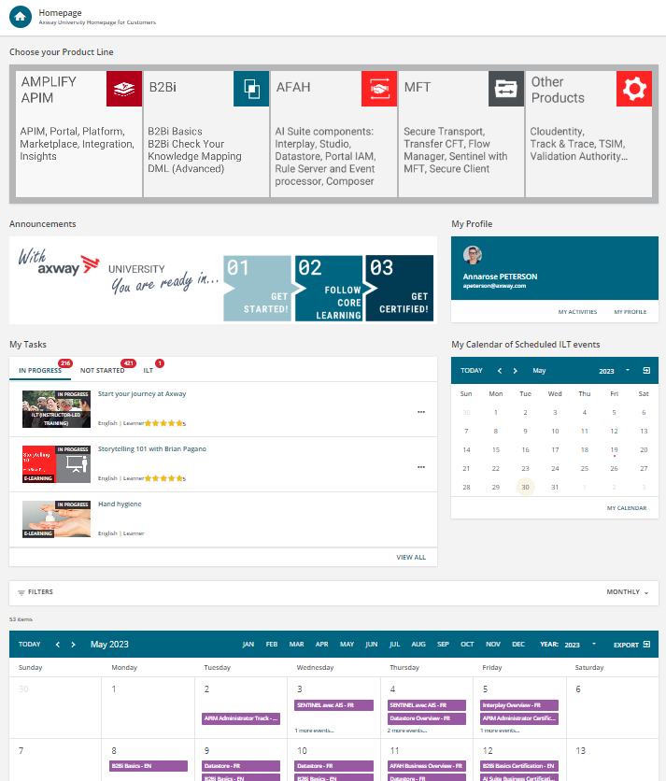
Homepage
HTML widget. Images for solutions are from Graphic for customer pages.
HTML frame: Framework for Select Productline widget.txt
Image widget. Image can be edited here: Graphic for customer pages
My Profile widget
Include options for My activities
My Task widget.
Three tabs included on this widget are:
In progress
Not Started
ILT
My Calendar widget
Catalog widget. Set to display only the “Full Customer” catalog, in calendar view.
All images and html frameworks found here: Homepage

Slide 7
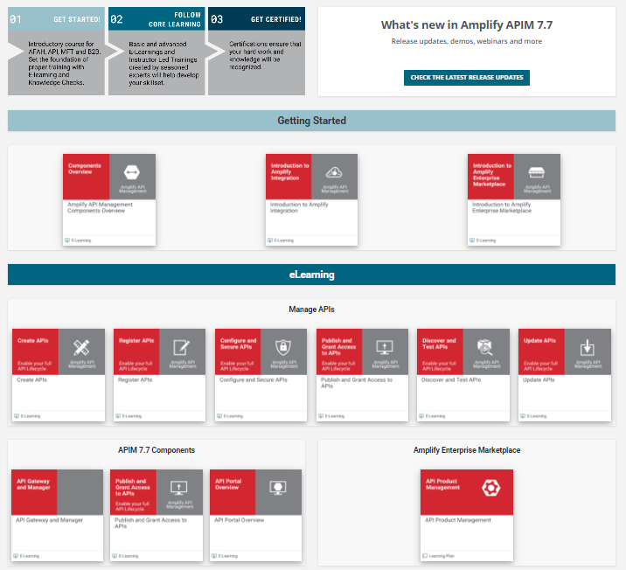
Amplify APIM Product Page Part 1
Custom Content widget. Linked to the What’s new in Amplify Learning plan
Image widget. Image from Graphic for customer pages.
HTML Widget: Get started label.txt
HTML Widget: Get started courses frame.txt
HTML Widget: elearning label.txt
All images and html frameworks found here: Amplify
HTML Widget: Manage APIs elearning frame full width.txt
HTML Widget
APIM 7.7 elearning frame half page width
HTML Widget
Enterprise markeplace elearning frame half width.txt

Slide 8
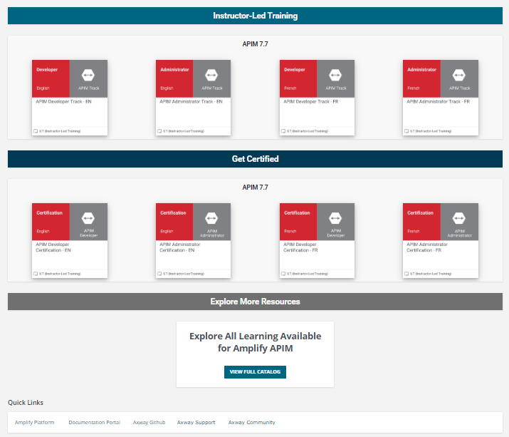
Amplify APIM Product Page Part 2
HTML Widget: Instructor led training label.txt
HTML Widget: APIM 7.7 ILT frame full width
HTML Widget: APIM 7.7 get certified frame full width
HTML Widget: Get certified label.txt
All images and html frameworks found here: Amplify
HTML Widget: explore more resources label.txt
Custom Content Widget:
Linked to Full Customer catalog with filter for Amplify API Management on the Offer.
HTML Widget: quick links.txt

Slide 9
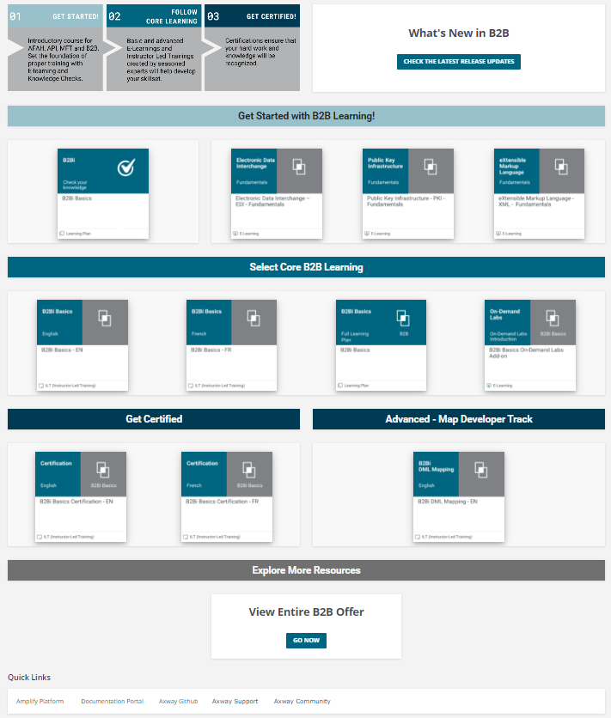
B2B
Image widget. Image from Graphic for customer pages.
All images and html frameworks found here: B2B
Custom Content widget. Linked to the most recent B2B Customer Tech enablement course
HTML Widget: check your knowledge third column width for get started section.txt
HTML Widget: get started label.txt
HTML Widget: get started elearning two third column width.txt
HTML Widget: core learning label.txt
HTML Widget: core learning frame full width.txt
HTML Widget: Advanced label half width.txt
HTML Widget: get certified label half width.txt
HTML Widget: advanced course frame half width.txt
HTML Widget: get certified course frame half width.txt
HTML Widget: explore more resources label.txt
Custom Content Widget:
Linked to Full Customer catalog with filter for B2B on the Offer.
HTML Widget: quick links.txt

Slide 10
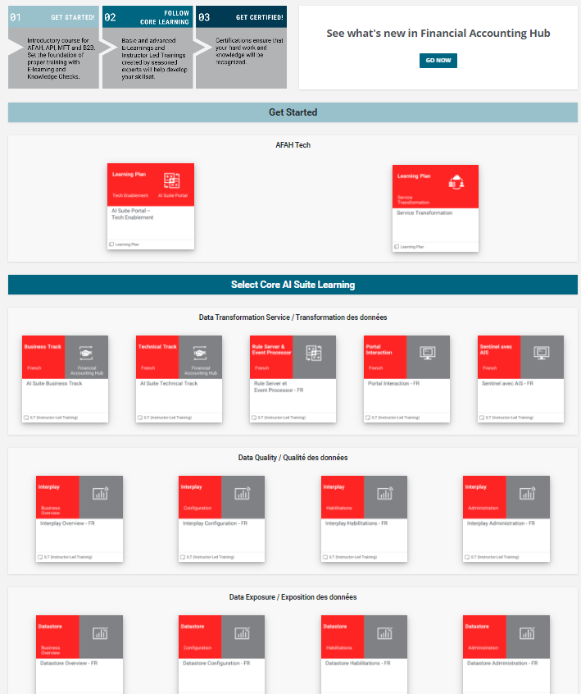
AFAH – Part 1
Custom Content widget. Linked to the What's new in AFAH LP
Image widget. Image from Graphic for customer pages.
HTML Widget: get started label.txt
HTML Widget: get started course frame full width.txt
HTML Widget: core ai suite learning label.txt
HTML Widget: data transformation frame full width.txt
HTML Widget: data quality frame full width.txt
All images and html frameworks found here: AFAH
HTML Widget: data exposure course frame full width.txt

Slide 11
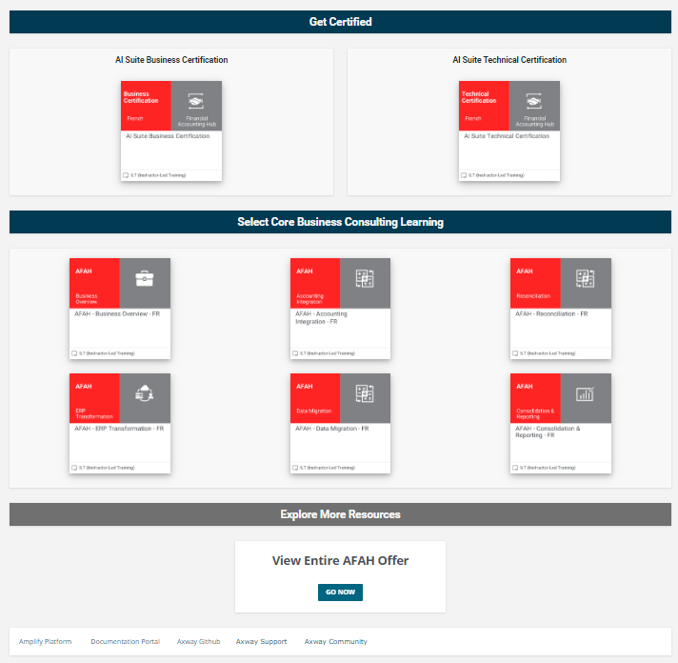
AFAH – Part 2
HTML Widget: get certified label.txt
HTML Widget: ai suite tech cert frame half width.txt
HTML Widget: ai suite business cert frame half width.txt
HTML Widget: core business consulting label.txt
HTML Widget: business consult course frame full width.txt
HTML Widget: explore more resources label.txt
Custom Content Widget:
Linked to Full Customer catalog with filter for AFAH on the Offer.
HTML Widget: quick links.txt

Slide 12
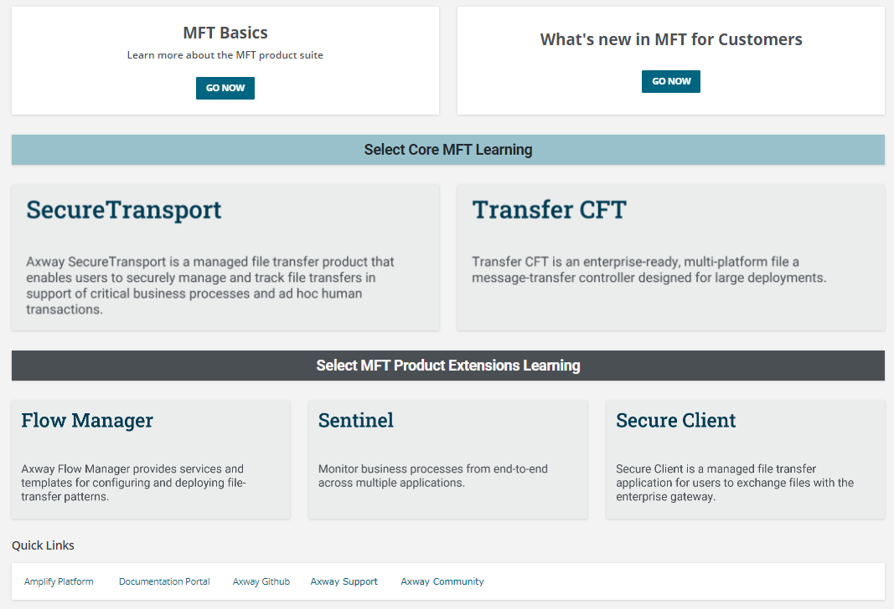
MFT
All images and html frameworks found here: MFT
Custom Content widget. Linked to the What’s new in MFT for Customers LP
Custom Content widget. Linked to the MFT Basics LP
HTML Widget: Core product label.txt
Image widgets – linked to their respective product pages
Image widgets linked to a catalog view of the Full Customer catalog filtered to each product
HTML Widget: prod ext label.txt
HTML Widget: quick links.txt

Slide 13
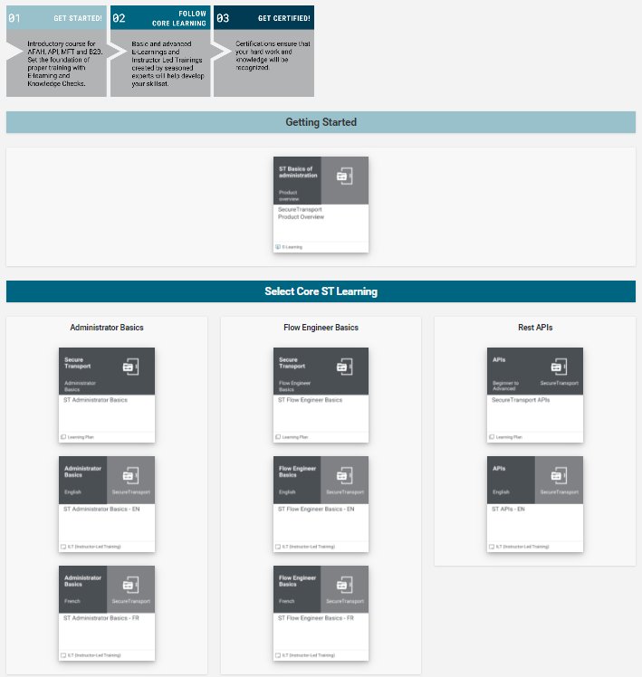
SecureTransport - Part 1
Reserved for custom content widget for when a What’s New item is available.
Image widget. Image from Graphic for customer pages.
HTML Widget: getting started label.txt
HTML Widget: get started course frame full width.txt
HTML Widget: core learning label.txt
All images and html frameworks found here: SecureTransport
HTML Widget: rest api course frame third width.txt
HTML Widget: Admin basics course frame third width.txt
HTML Widget: flow engineer course frame third width.txt

Slide 14
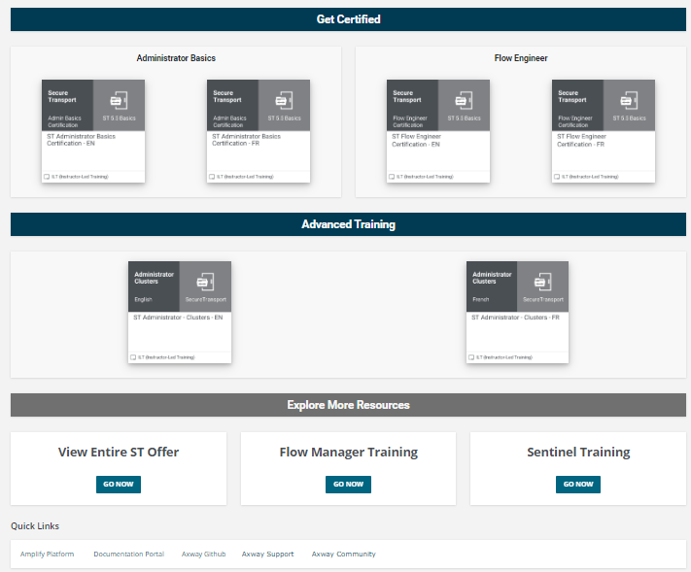
SecureTransport - Part 2
HTML Widget: get certified label.txt
HTML Widget: flow engineer cert course frame half width.txt
HTML Widget: admin basics cert course frame half width.txt
HTML Widget: advanced training label.txt
HTML Widget: advanced training course frame half width.txt
HTML Widget: explore more resources label.txt
Custom content linked to full customer catalog, filtered to ST
Custom content linked to full customer catalog, filtered to Sentinel
Custom content linked to full customer catalog, filtered to Flow Manager
HTML Widget: quick links.txt

Slide 15
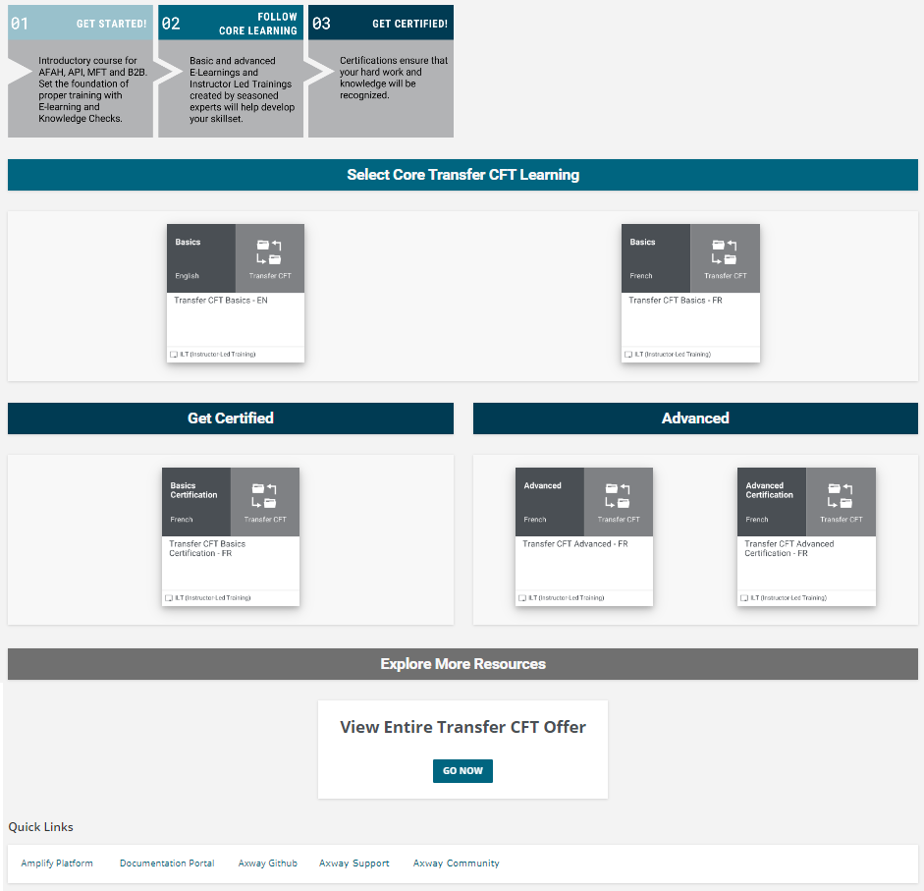
Transfer CFT
All images and html frameworks found here: Transfer CFT
Reserved for custom content widget for when a What’s New item is available.
Image widget. Image from Graphic for customer pages.
HTML Widget: core learning label.txt
HTML Widget: getting started label.txt
HTML Widget: getting started label.txt
HTML Widget: getting started label.txt
HTML Widget: getting started label.txt
HTML Widget: getting started label.txt
HTML Widget: getting started label.txt
Custom content linked to full customer catalog, filtered to ST
HTML Widget: getting started label.txt

